Slide 1
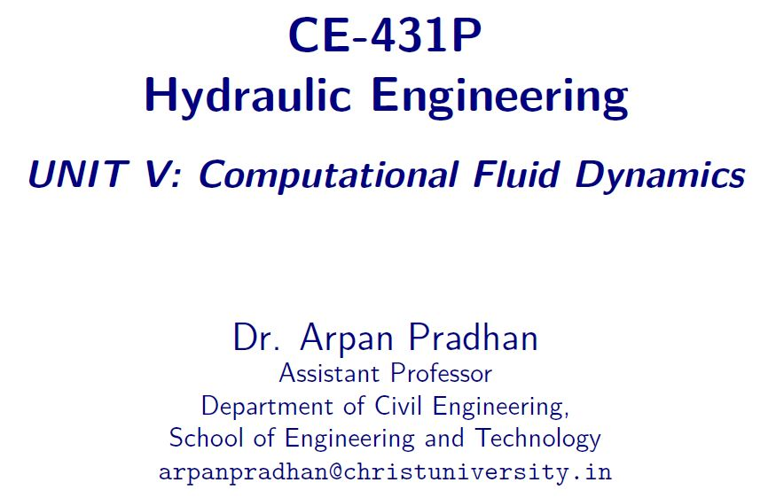

Slide 2
Contents
CFD Discretization
Substantial and Partial Derivative
Acceleration

Slide 3
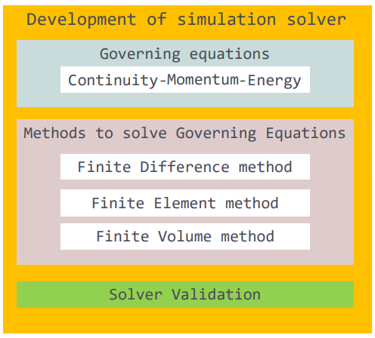
Computational Modeling – simulation solver

Slide 4
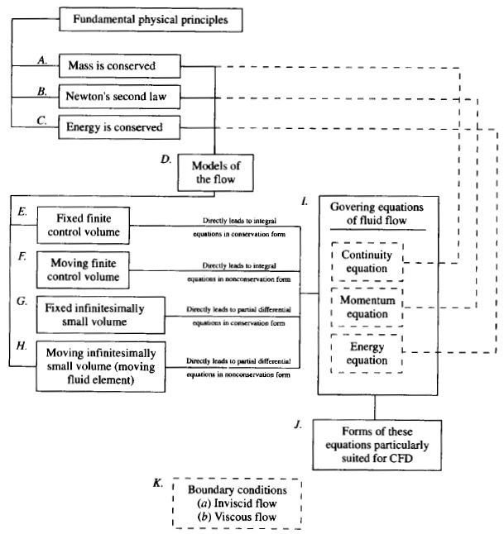
Computational Modeling

Slide 5
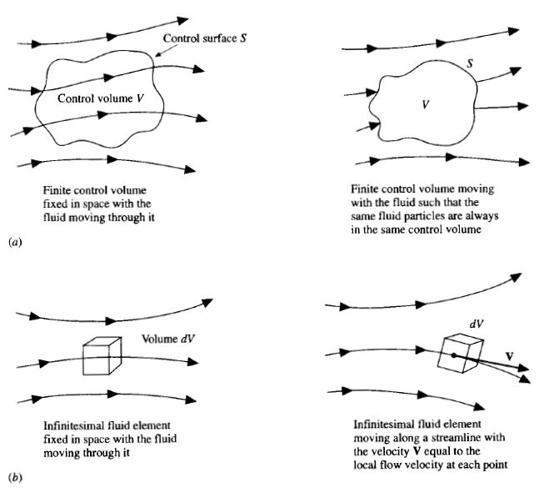
Computational Modeling

Slide 6

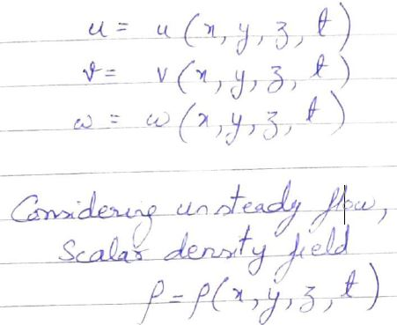
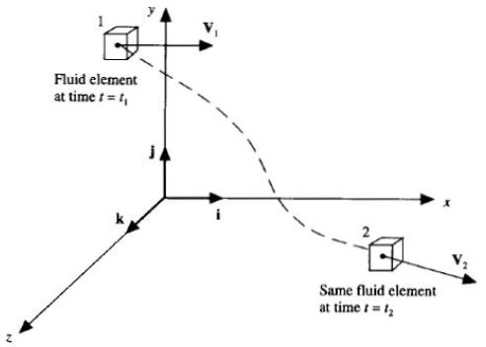
Substantial and partial derivatives

Slide 7
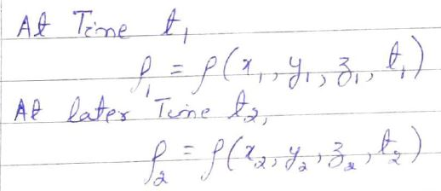


Substantial and partial derivatives

Slide 8
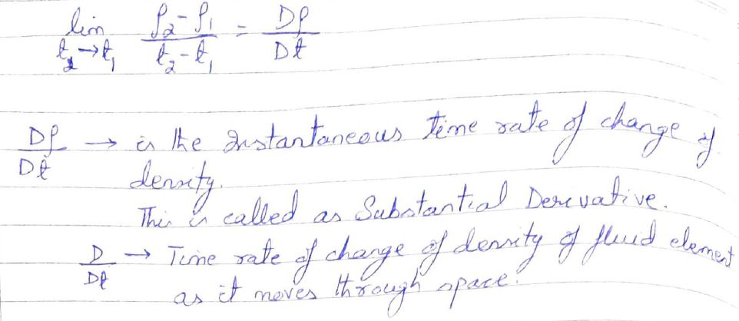
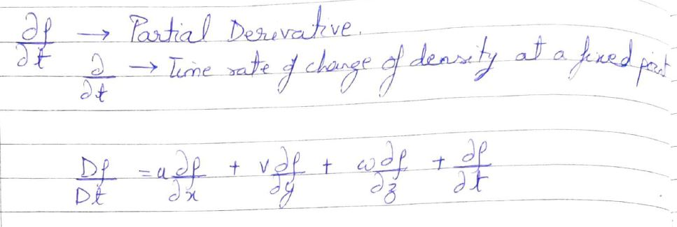
Substantial and partial derivatives

Slide 9


